Slide 1
Remote Rendering VU Echtzeit-Visualisierung
David Pfaher and Bernhard Rainer

Slide 2
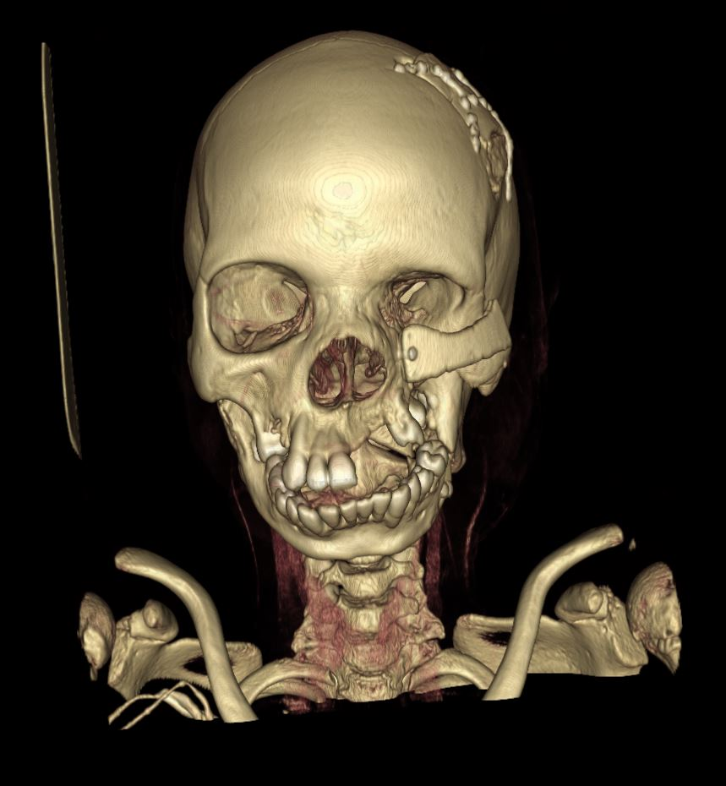
Motivation
Huge Volume Data Sets
Portable Devices for Patience Communication (Tablets…)

Slide 3
Outline
Screen Tiling
Network Communication in Unity
Demo

Slide 4
Outline
Demo!!
Screen Tiling
Network Communication in Unity

Slide 5
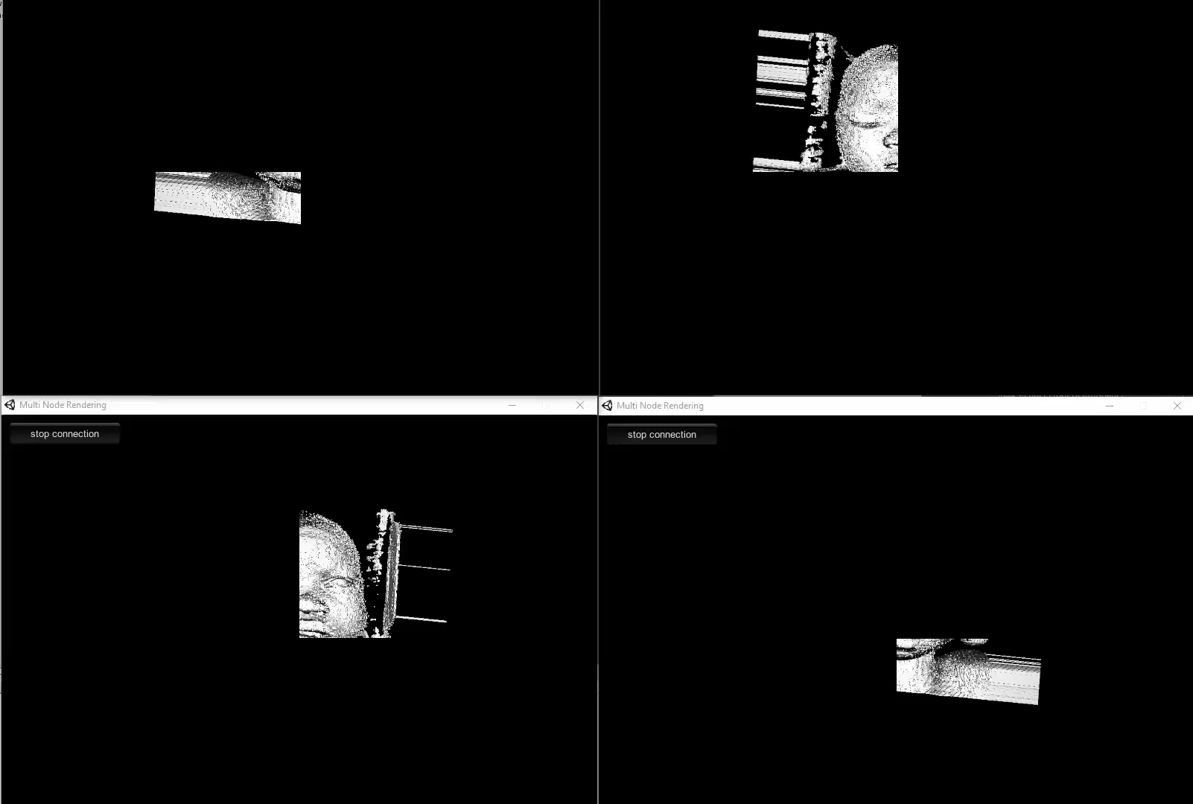
Results – Client Nodes

Slide 6
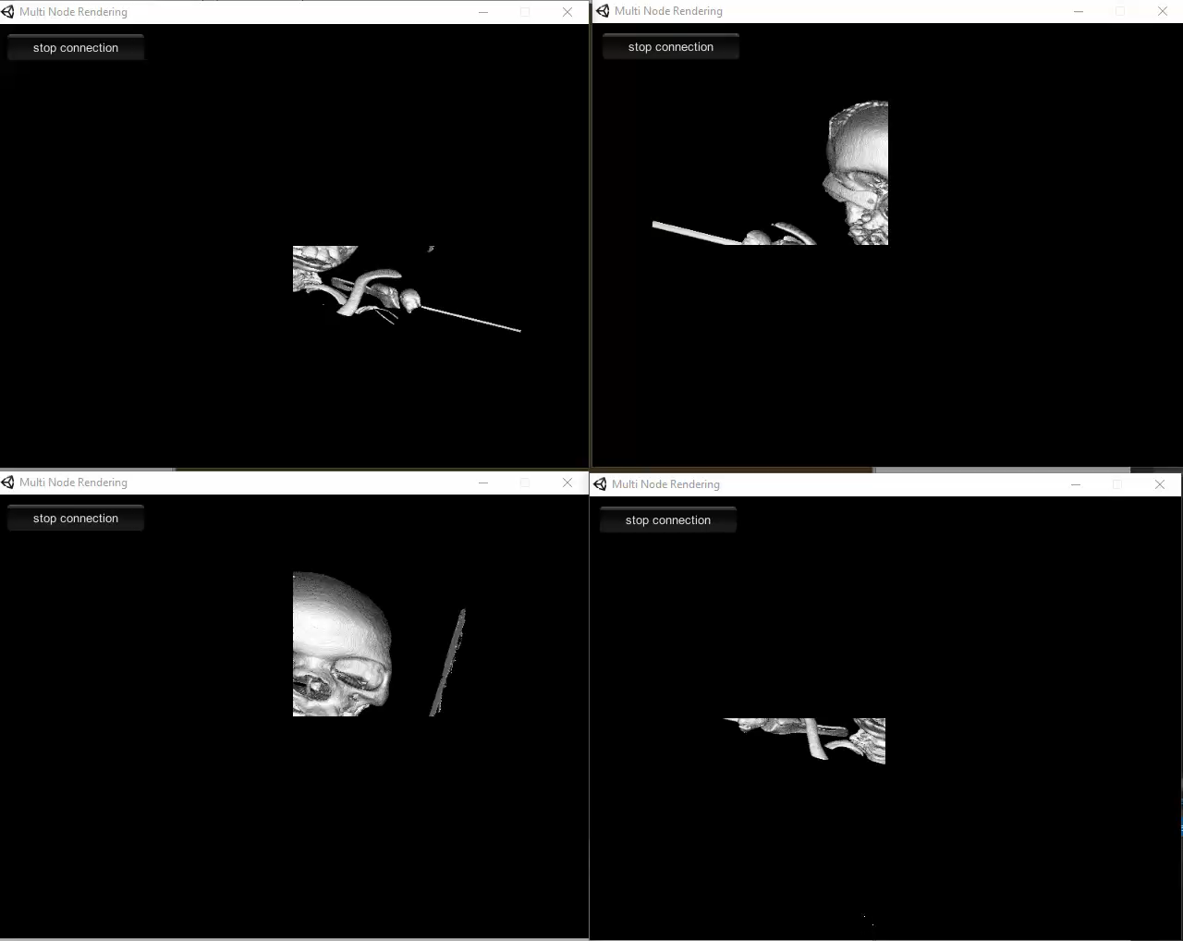
Results – Client Nodes

Slide 7
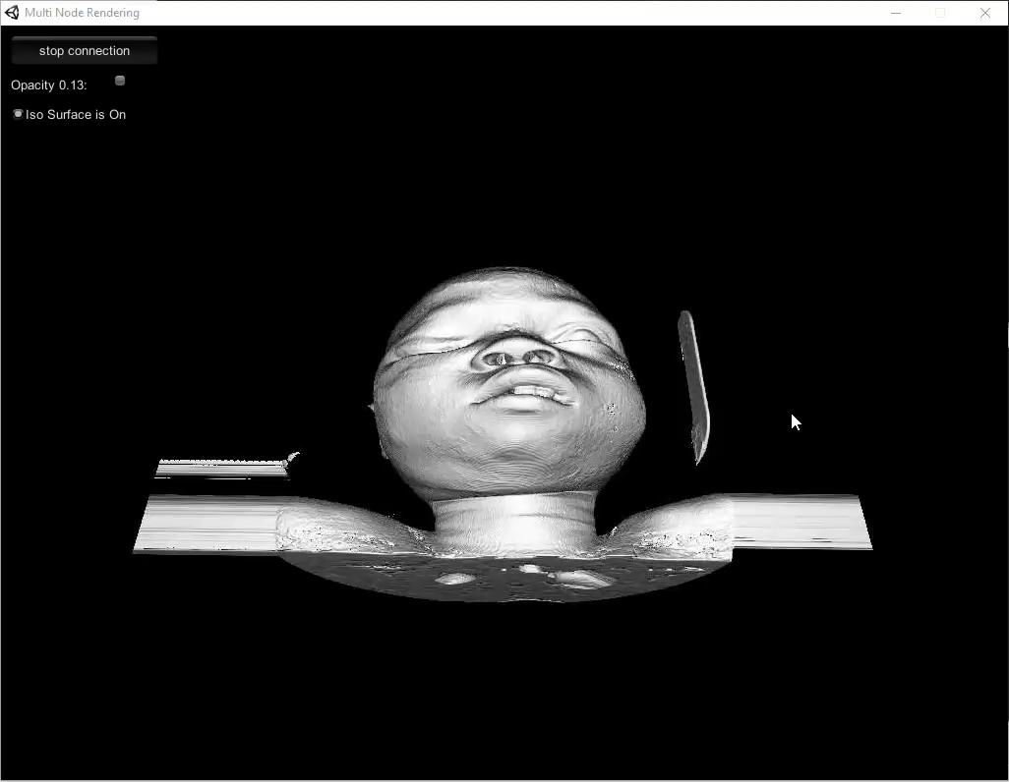
Results - Server

Slide 8
Outline
Demo
Screen Tiling
Network Communication in Unity

Slide 9
Screen Tiling

Slide 10
Screen Tiling

Slide 11
Outline
Demo
Screen Tiling
Network Communication in Unity

Slide 12
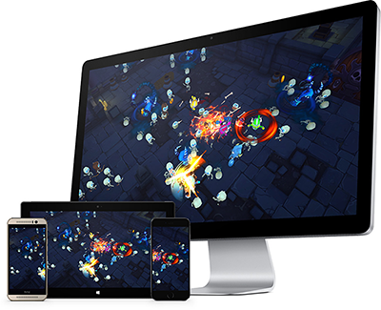
Network Communication
High level scripting API
Super simple ☺
Only UDP ☹
Low Level API
More Configuration possibilities ☺
But complex ☹

Slide 13
Network Communication
//create configuration containing one reliable channel m_CommunicationChannel = m_Config.AddChannel( QosType.UnreliableFragmented);
Relatively easy channel configuration.
Also possible to configure maximal number of connections.

Slide 14
Conclusions
Transfer of Textures over Network is the Bottleneck

